Slide 1
Group:5
1.Salman Farshi
2.Md. Ashiquer Rahman 3.Iftakarul Islam Suvo
Superviser : Shahnewaz Siddique

Slide 2
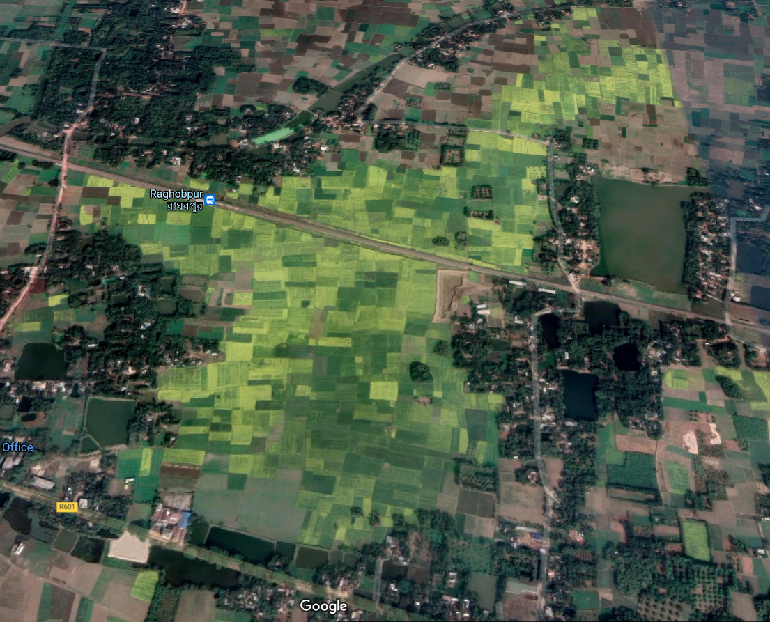
Detecting arable/none_arable land from satellite images using Yolov5

Slide 3
MOTIVATION
1. Bangladesh is a densely populated country. The population here is increasing day by day.
2. Due to this huge increase in population many arable lands are converted to buildings, complex etc. So, we are in a position of lack of farmable lands now.
3. There are also many lands which are arable but farming hasn’t started there yet because of no detection.
4. For this reason, the food production process is being hampered. We are not capable of feeding a huge population of 180 million with farming lands we have now.
5. We must look for new farmable lands across the country

Slide 4
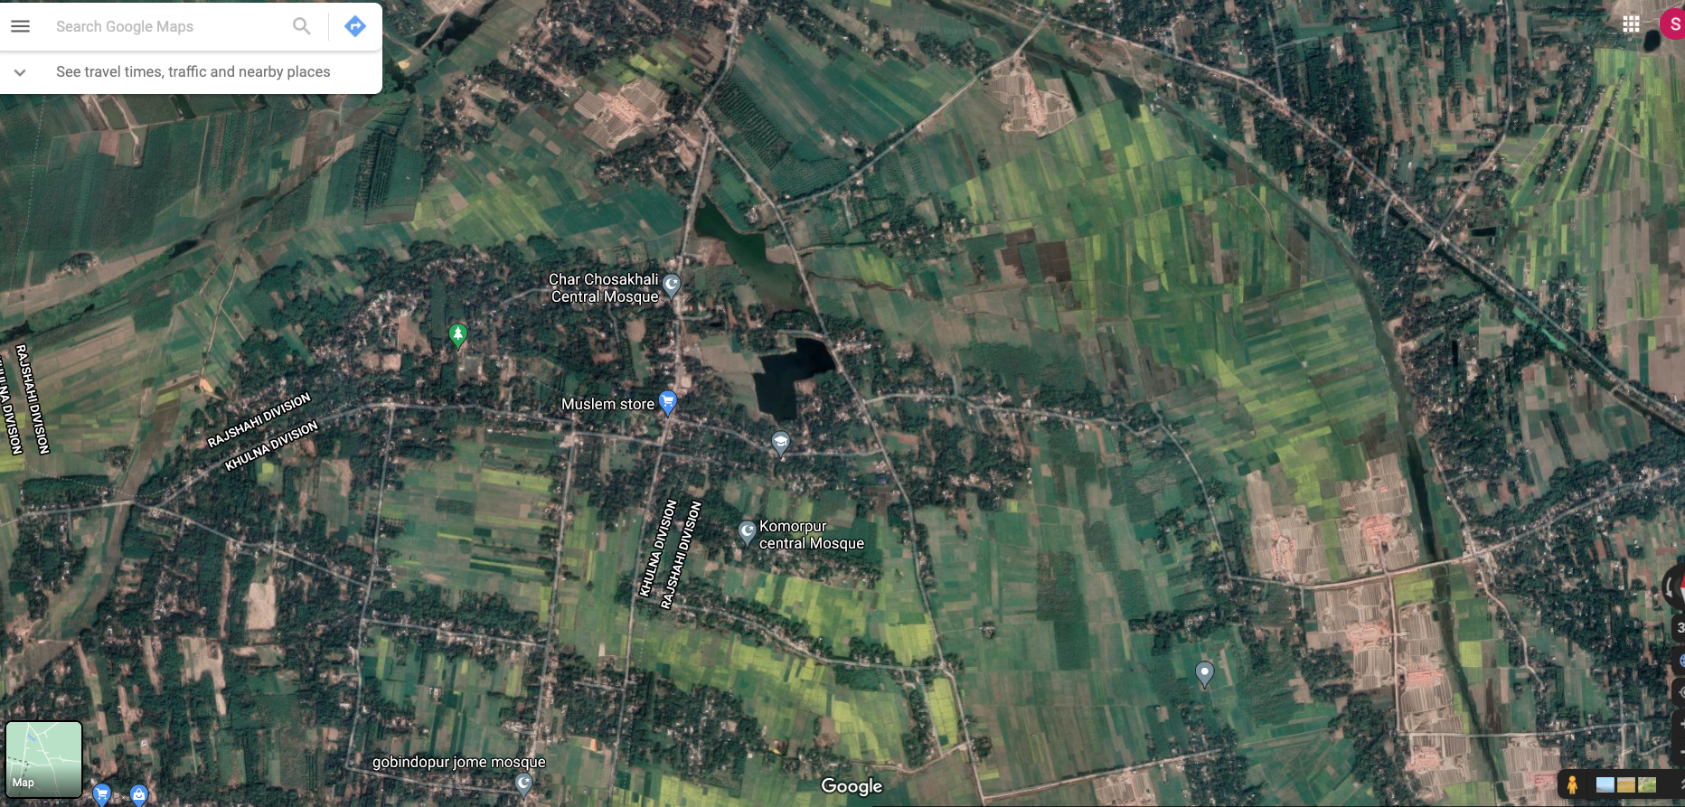

Slide 5
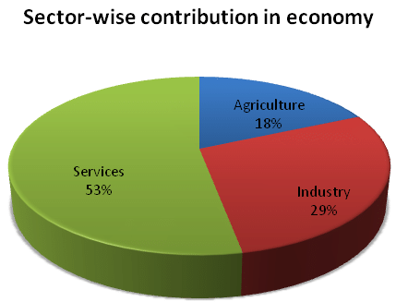
MOTIVATION
Why Deep learning for Agriculture ?
If computer has vision , so why not use of it
1.Easy to Detect
2.Short Time
3.Less Costly 4.Easy to Manage 5.Better Accuracy

Slide 6
What is Yolov5?
What is YOLO?
YOLO stands for You Only Look Once. YOLO is a state-of-the-art, real-time object detection system. It was developed by Joseph Redmon. It is a real-time object recognition system that can recognize multiple objects in a single frame. YOLO has evolved into newer versions over time, viz., YOLOv2, YOLOv3, YOLOv4 ,YOLOv5 and YOLOv8.
YOLOv5 : YOLOv5 is a state-of-the-art object detection algorithm that belongs to the You Only Look Once (YOLO) family of real-time object detection models. It was developed by Ultralytics and released in mid-2020 as an upgrade to previous versions like YOLOv1, YOLOv2, YOLOv3.
YOLOv5 is known for its speed, accuracy, and ease of use. It employs a single-stage object detection approach, which means it processes the entire image in one pass and directly predicts bounding boxes and class probabilities for objects within the image.

Slide 7
Project workflow
Information gathering
image collection
Image preprossesing
Annotatation
Enviroment setup
Data training
Data testing
Result evalution

Slide 8
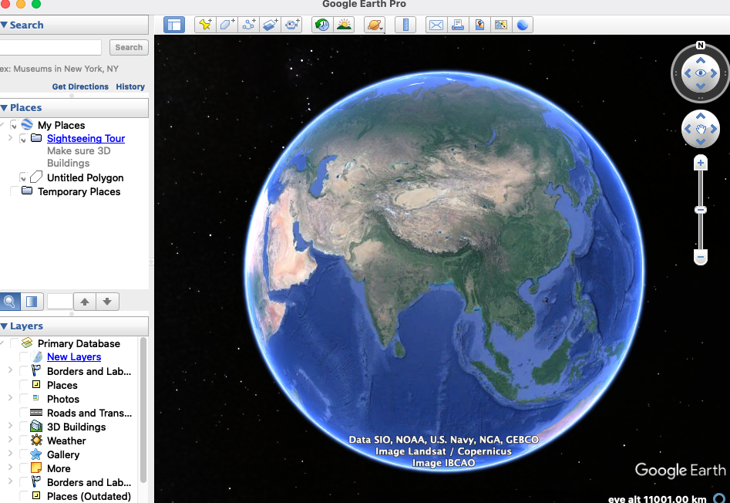
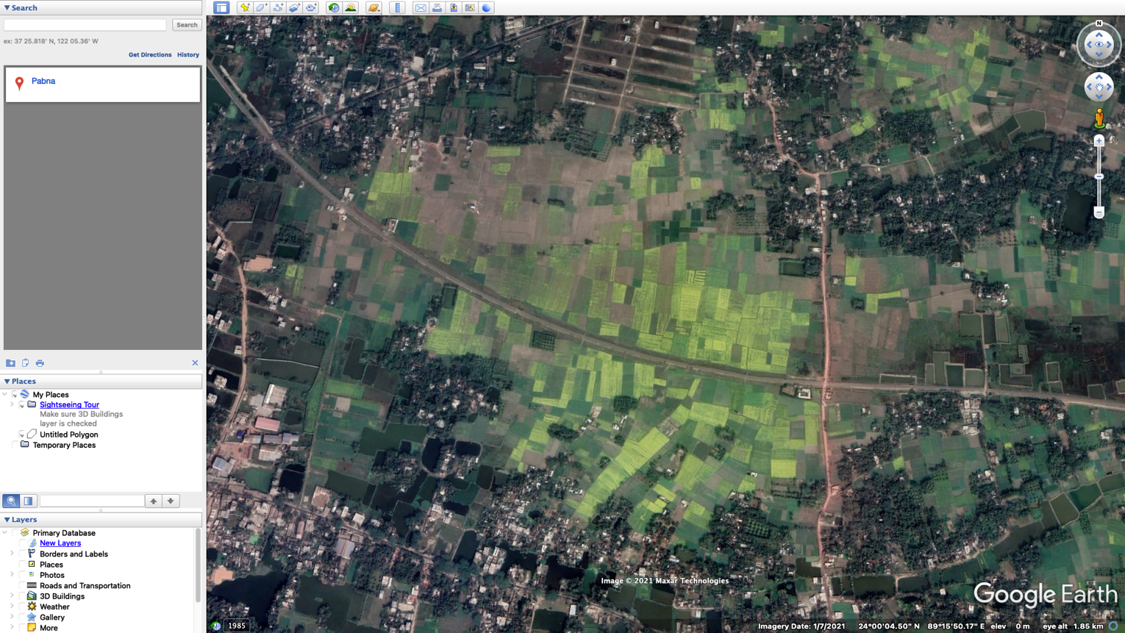
Image collection

Slide 9
Training &Testing
After collecting images through Google earth and labelled data; we divided the data into two parts. First part is 80%, training data; rest 20% are testing data
After collecting images through Google earth and labelled data; we divided the data into two parts. First part is 80%, training data; rest 20% are testing data. We have run 60 epochs through the training data. The accuracy at 55 epoch was 76%. After that point, the accuracy went downwards and stopped at 60%- 65%. So, we stored the primary 55 epoch as best weight.The precision was 78%, recall was 77%F1 score was 76%. Mean average precision or accuracy was 76%.

Slide 10
Results & output
mean average precision
(mAP@0.50) = 0.76, or 76%
wasteland:80%
arable:73%
none_arable:70%
(non-cultivated)

Slide 11
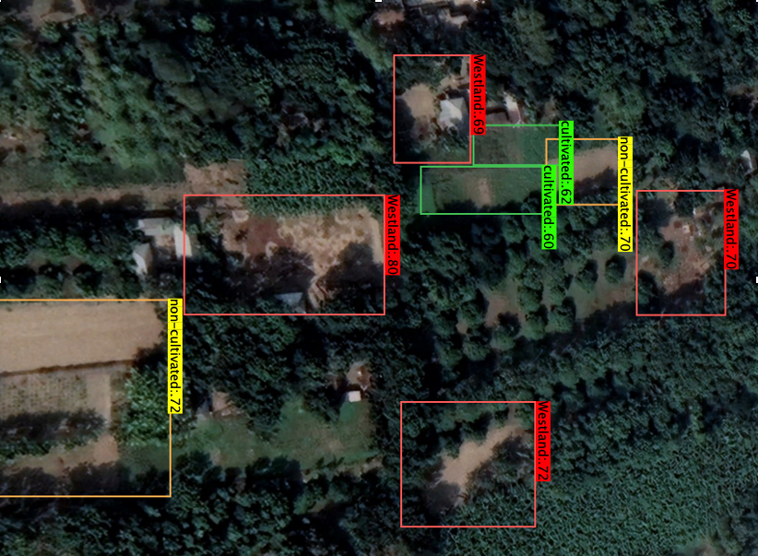
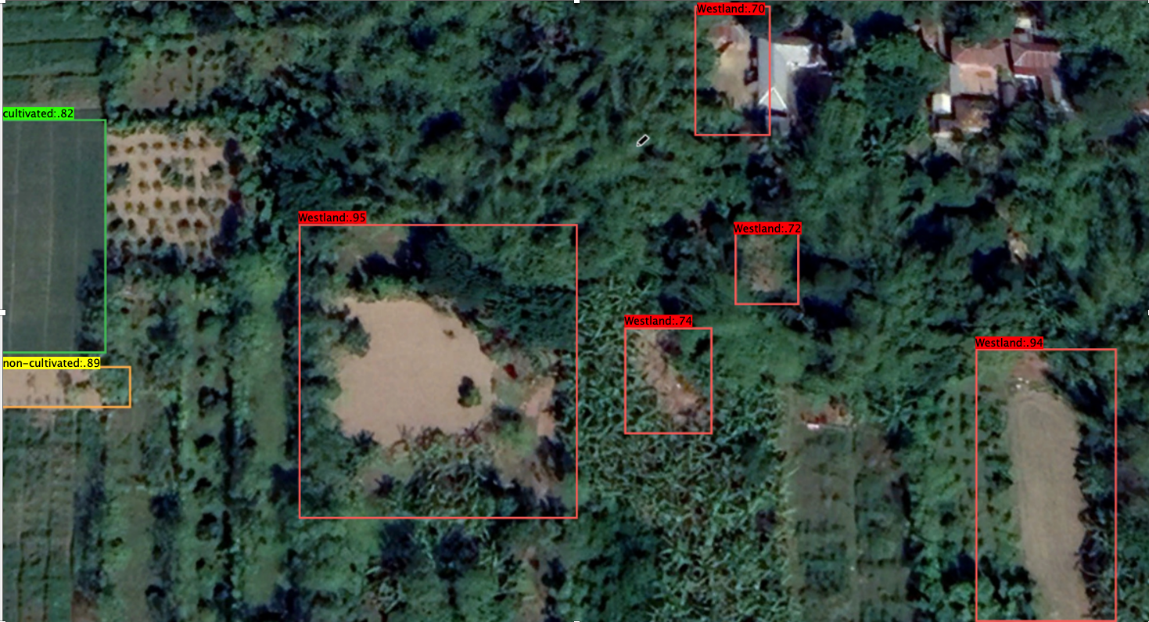
Output

Slide 12
Disscusion
We have completed our research successfully. Our algorithm could Arable non Arable(Non-Cultivated) and wasteland successfully upto 76% accuracy. In the near future, we would like to add a bigger picture to the
research. We will collect 2000-3000 images in order to measure accuracy. Hopefully, our result will be more
accurate then. As we mentioned before, if our research becomes successful in Bangladesh, we will do the same for the countries alike toBangladesh. We hope to achieve our goal very soon.

Slide 13
Conclusion
Using the ‘YOLO v5’ algorithm to detect lands was a great achievement for us. We did label the images pretty much correctly with ‘Labeling’. Our data was unique also as it is based on districts on Bangladesh. Hopefully, this result will
contribute to reduce the food crisis problem of Bangladesh perfectly and very soon we will be citizens of a country
where there is no food crisis.

Slide 14
THANK YOU

